Slide 1


Drops of LTSpice
Understanding and using the MEASURE Statement

Slide 2
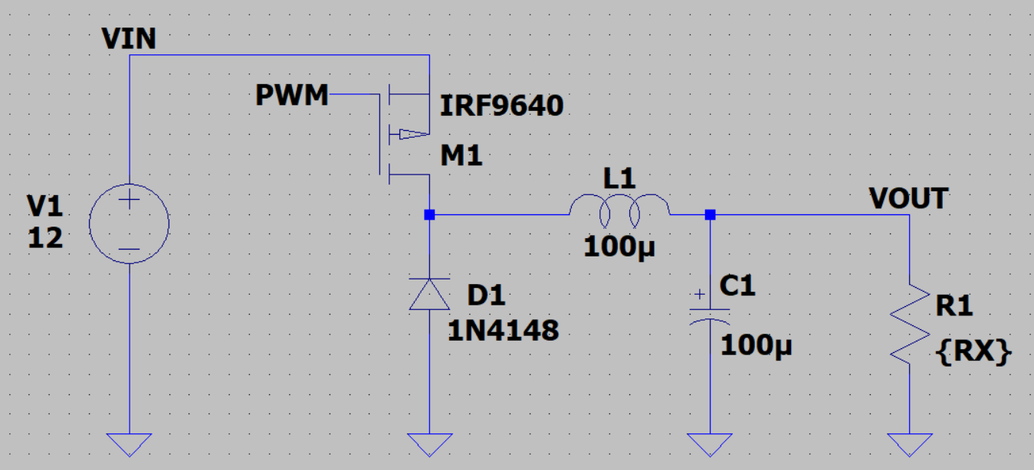
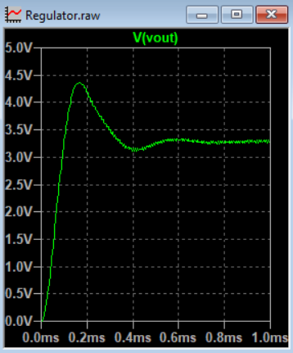
So, you created a really cool regulator, and it is working fine.
But how do you calculate how efficient your regulator is?

Slide 3
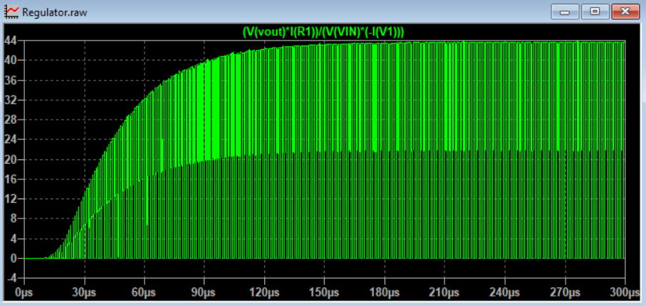
Yes, you can put that on the graph...
...but for a switching regulator, this is not an easy job.

Slide 4
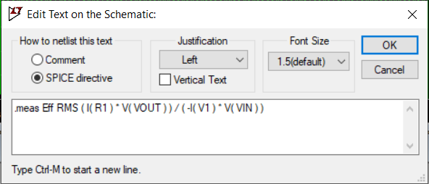
The best way is to take a measurement. To do this, LTSpice has a very useful statement.
This is the .MEASURE,
or .MEAS for short.

Slide 5
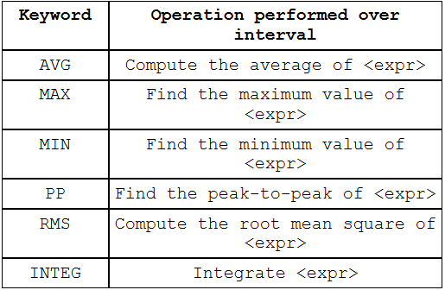
The structure of the most basic MEASURE directive is…
.MEAS Pout RMS V( vout ) * I( R1 )
Possible operations are…
Name
Operation
Expressions

Slide 6
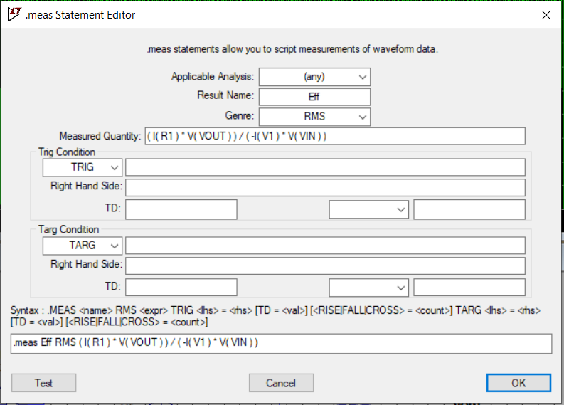
Once you add the statement, LTSpice allows you to change it in a specific editor.

Slide 7

In our circuit, to calculate the efficiency we need the following expression
However, we cannot use instantaneous power. So, let's separate it into 3 measures
.MEAS Pout RMS I(R1)*V(VOUT)
.MEAS Pin RMS -I(V1)*V(VIN)
.MEAS Eff PARAM Pout/Pin

Slide 8
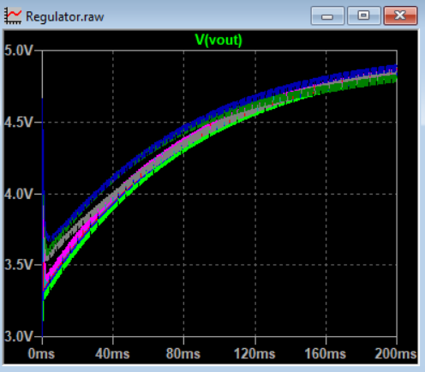
And after almost 3 hours, our simulation is ready.
But where are the results?

Slide 9
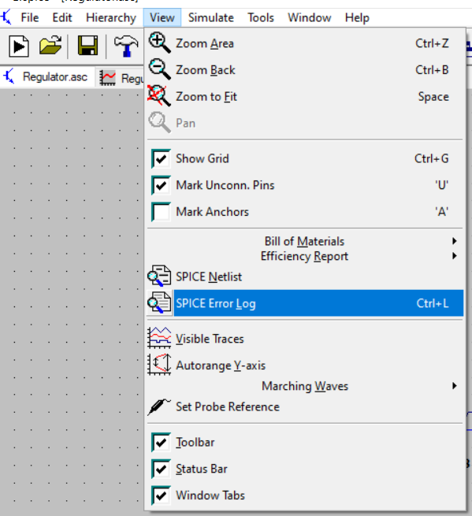
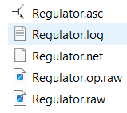
To see the result, you need to open the SPICE Error Log.
The same result is also in the LOG file.

Slide 10
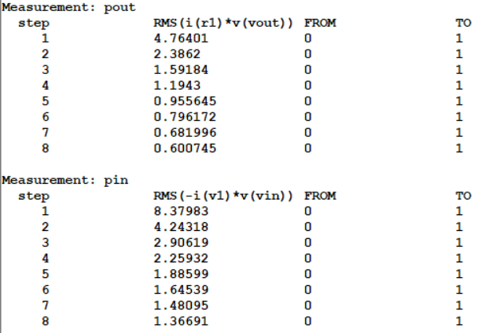
The first result is the Input and Output Power

Slide 11
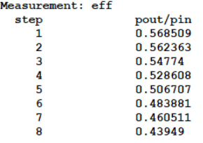
And here,
the efficiency of this circuit.
Francesco Sacco
linkedin.com/in/saccofrancesco

